Slide 1





Recommendation system
Collaborative Filtering and Content-Based Filtering
Get Started

Slide 2




PRESENTED BY:
Mudraboina Mallika
21NH1A0580
Sala Sridevi
21NH1A0598
Sykam chandu
21NH1A05A3
Thadanki Pravallika
21NH1A05A4
Under The Esteemed Guidance Of:
Mrs.K. Lakshmi Prasuna M.Tech
Dept of CSE

Slide 3
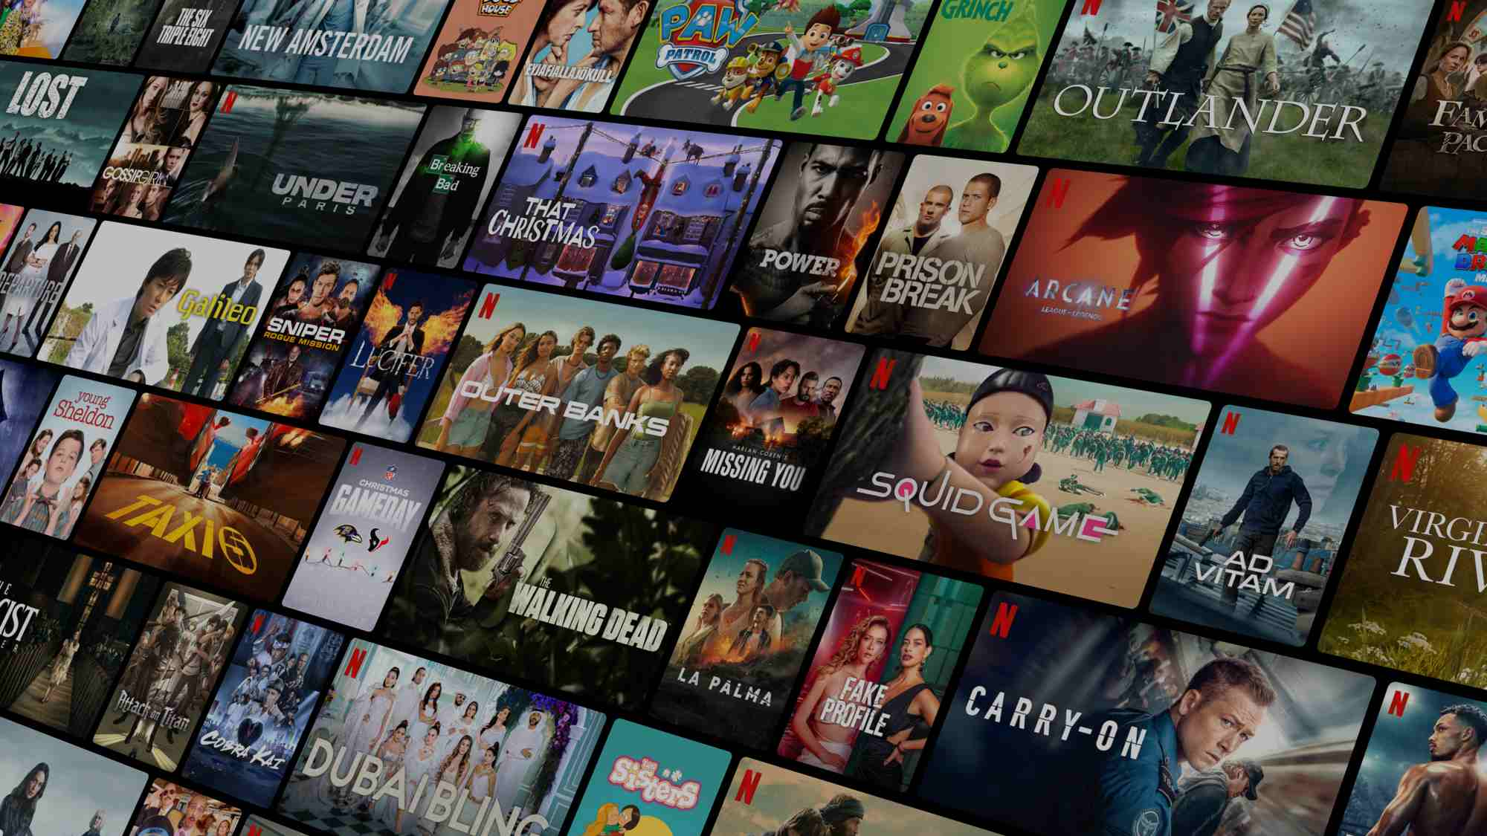

TABLE OF CONTENT:
INTRODUCTION
ABSTRACT
EXISTING SYSTEM
PROPOSED SYSTEM
SYSTEM SPECIFICATION
HOW IT WORKS
COLLABORATIVE FILTERING
MODEL IMPLEMENTATION
USE CASE DIAGRAM
CONTENT-BASED FILTERING
WHAT MAKES US UNIQUE?
RESULTS & ANALYSIS
CONCLUSION
ANY QUERIES

Slide 4










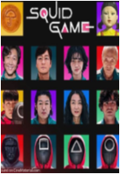


INTRODUCTION:
Friday July 8th
Drama | Thriller | Supernatural
Stranger Things
In the modern digital era, recommendation systems play a crucial role in enhancing user experience. This project focuses on building a Movie Recommendation System using Collaborative Filtering (CF) approaches. Both model-based and memory-based approaches are implemented to improve recommendation accuracy.
2019 | Director: Shawn Levy | Seasons: 3 (5 Episodes)
Welcome to the Fantasy World, a realm of wonder and enchantment where anything is possible. Here, dragons breathe fire, unicorns prance through meadows, and rainbows shine brightly.
STREAM NOW
ALL EPISODES
Example:-Just like Netflix, Amazon Prime, and other streaming platforms, which display recommendations based on user preferences (as shown beside), this system personalizes movie suggestions for a better viewing experience.
POPULAR THIS WEEK
16+

Slide 5

ABSTRACT:
In the modern digital era, recommendation systems play a crucial role in personalizing user experiences. This project focuses on building a Movie Recommender System using Collaborative Filtering (CF) approaches. These two methods complement each other by leveraging both user preferences and item similarities to provide accurate recommendations.
The Collaborative Filtering model is implemented using both model-based and memory-based approaches. The model-based CF utilizes Singular Value Decomposition (SVD) to learn latent factors, while the memory-based CF is developed using user-user and item-item similarity measures. One of the limitations of CF is the cold-start problem, where new items cannot be recommended effectively due to a lack of prior user interaction.
On the other hand, the Content-Based Filtering model generates recommendations by analyzing item attributes rather than relying on user interactions. This approach assumes that if a user likes a particular movie, they are likely to enjoy similar movies based on features such as genre, cast, and plot. Unlike CF, content-based filtering does not require data from multiple users, making it more effective for personalized recommendations.

Slide 6
EXISTING SYSTEMS:
Several movie recommendation systems currently in use follow simple models like popularity-based and top-rated filters.
Netflix (Old Model) Earlier versions of Netflix’s recommendation system relied heavily on user ratings without deep pattern recognition, offering only limited personalization.
YouTube Recommendations YouTube also recommends content based on watch history and popularity. However, these systems often repeat the same genre or popular content and fail to explore user interest diversity.

Slide 7
PROPOSED SYSTEM:
Uses Collaborative Filtering algorithms for personalized movie recommendations
Employs techniques like User-Based and Item-Based Filtering to predict user interests
Processes user ratings using Pandas and NumPy to create a user-item interaction matrix
CONVERT.PY Converts raw dataset files into clean CSV format for easy processing
COLLABORATIVE-FILTERING.PY Applies collaborative filtering logic to compute recommendations
CONTENT-BASED.PY
Uses movie content features (like genre, description) for similar movie suggestions.
APP.PY Runs the web application, takes movie input, and returns recommendations

Slide 8
SYSTEM SPECIFICATIONS:
HARDWARE
Basic Computer or Laptop
Internet Browser
Optional: External Monitor for better UI display
Storage: 2 – 4 GB (for datasets, environment, and libraries)
SOFTWARE
Python 3.7 or higher
Flask (for web app)
Pandas
NumPy
Scikit-learn
Matplotlib / Seaborn(for data visualization)

Slide 9


HOW IT WORKS:
Collaborative Filtering
Content-based Filtering
Collaborative filtering is a technique used in recommendation systems that suggests items based on user behavior and preferences. It analyzes patterns from multiple users to make predictions about what a particular user might like.
Movies you love, recommendations that match! Content-based filtering suggests films based on their features—genres, actors, directors, and keywords—matching your unique taste.

Slide 10
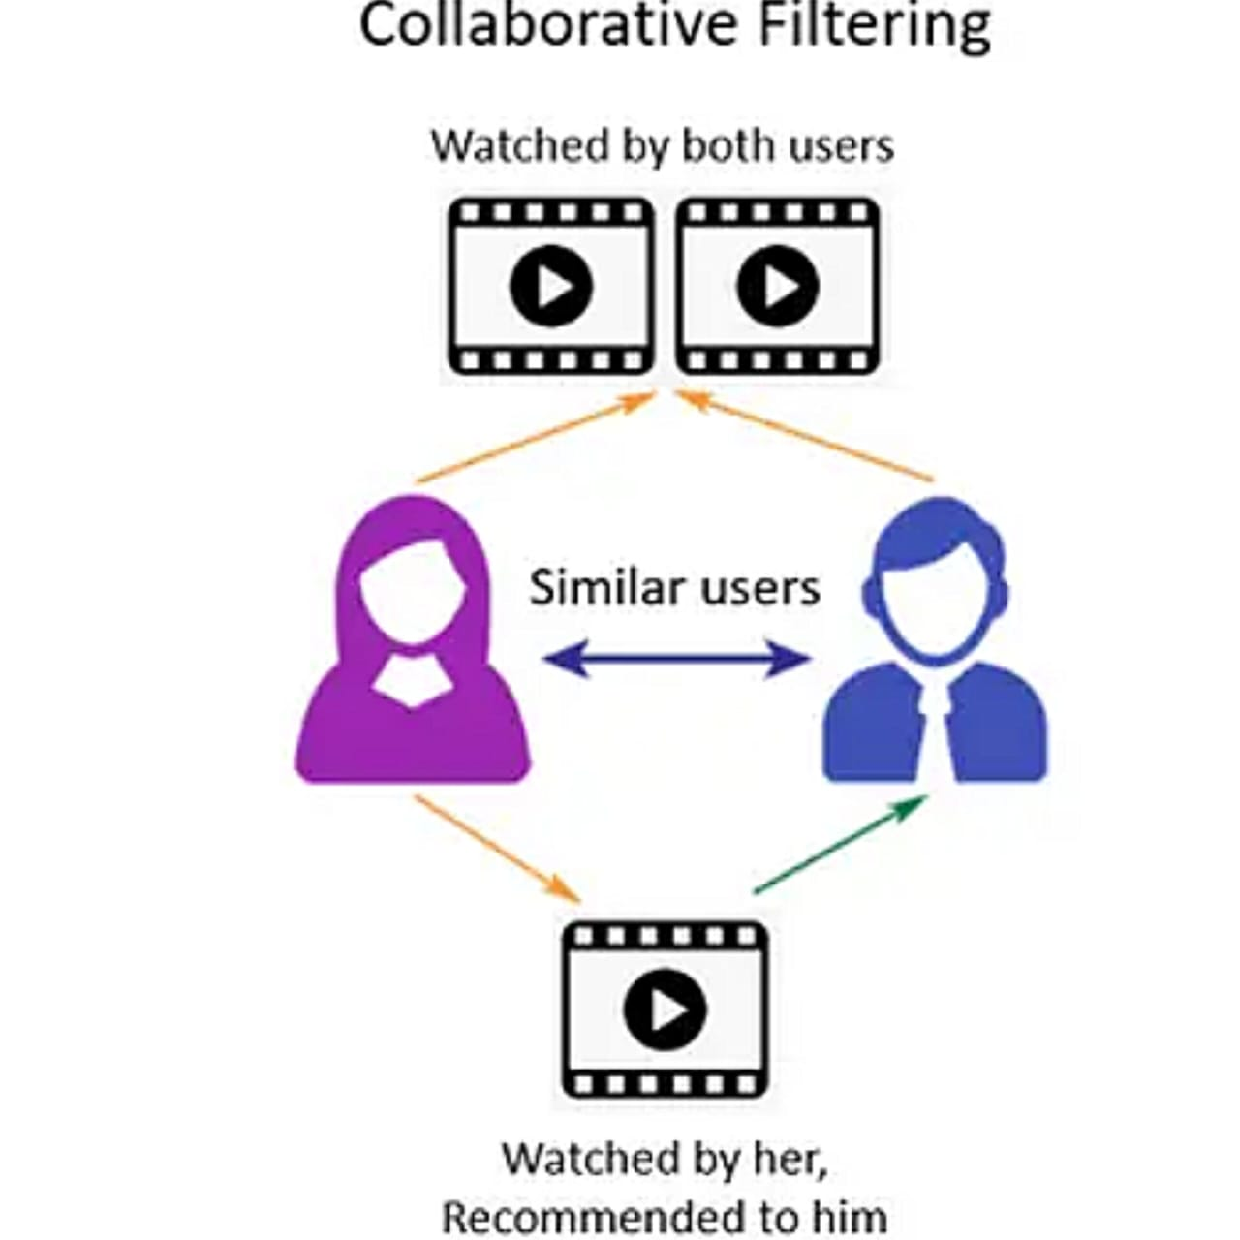
.
COLLABORATIVE FILTERING:
Collaborative Filtering involves predicting user preferences by analyzing past interactions.
- User-User Similarity: Based on similar user preferences.
- Item-Item Similarity: Based on similarities between items.
- No Need for Item Metadata: Works purely on user-item interactions.
- Scalable with Large Data: Performs better with more user ratings.
Challenge:
Cold-start problem for new users.

Slide 11

MODEL IMPLEMENTATION:
Data Preprocessing: Cleaning and formatting the data.
Collaborative Filtering: Implemented using both memory-based and model-based approaches.
User-Item Matrix: Created for rating prediction.
Data Splitting: Divided into training and testing sets (e.g., 80:20 ratio).
Model-Based Approach: Used algorithms like SVD (Matrix Factorization).

Slide 12
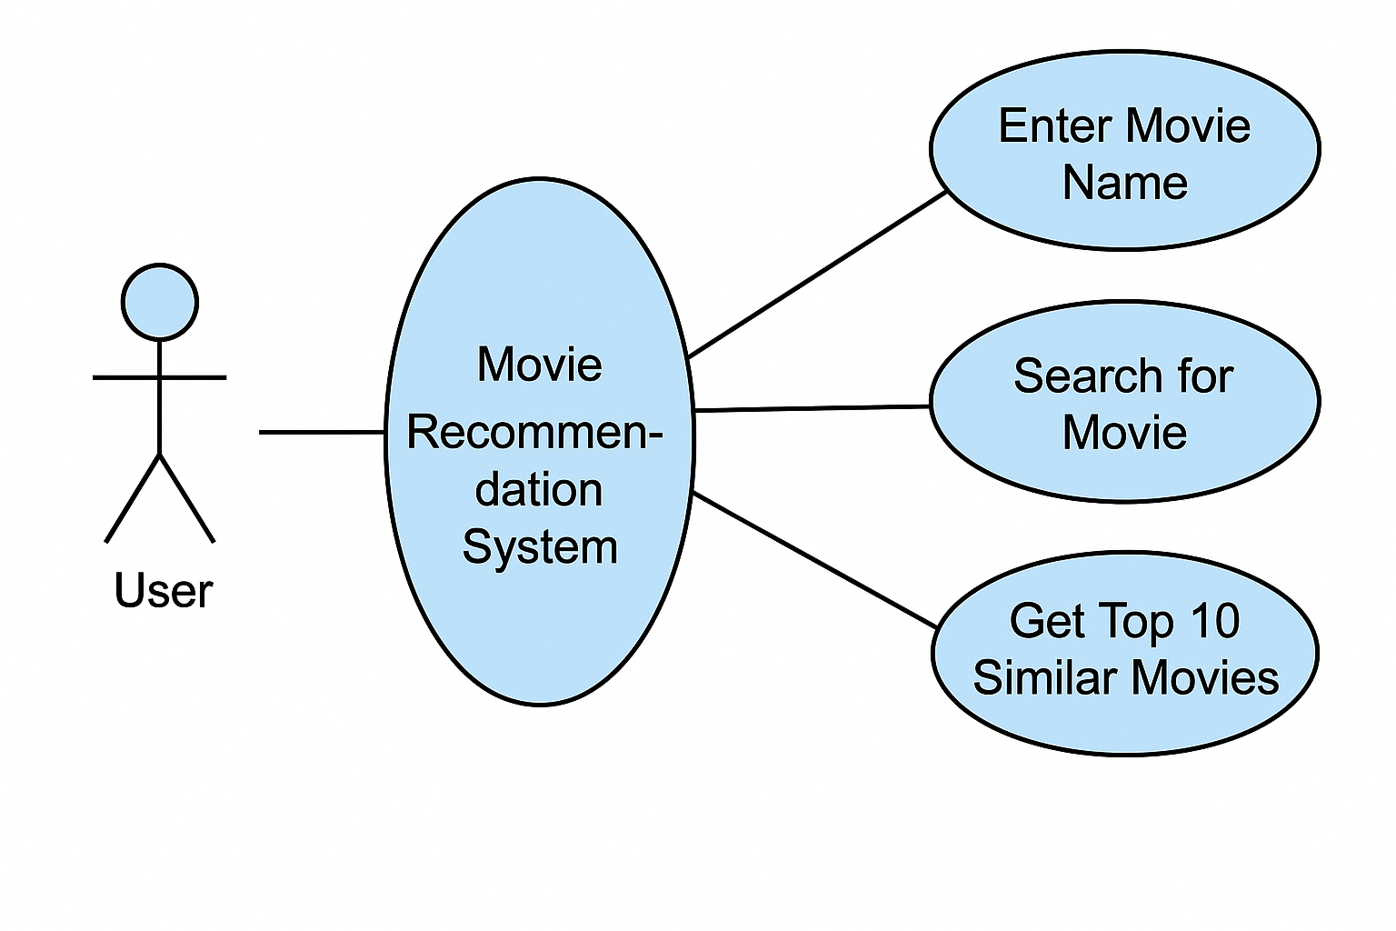
USE CASE DIAGRAM:
User
├──> Enter Movie Name
├──> Search for Movie
└──> Get Top 10 Similar Movies

Slide 13
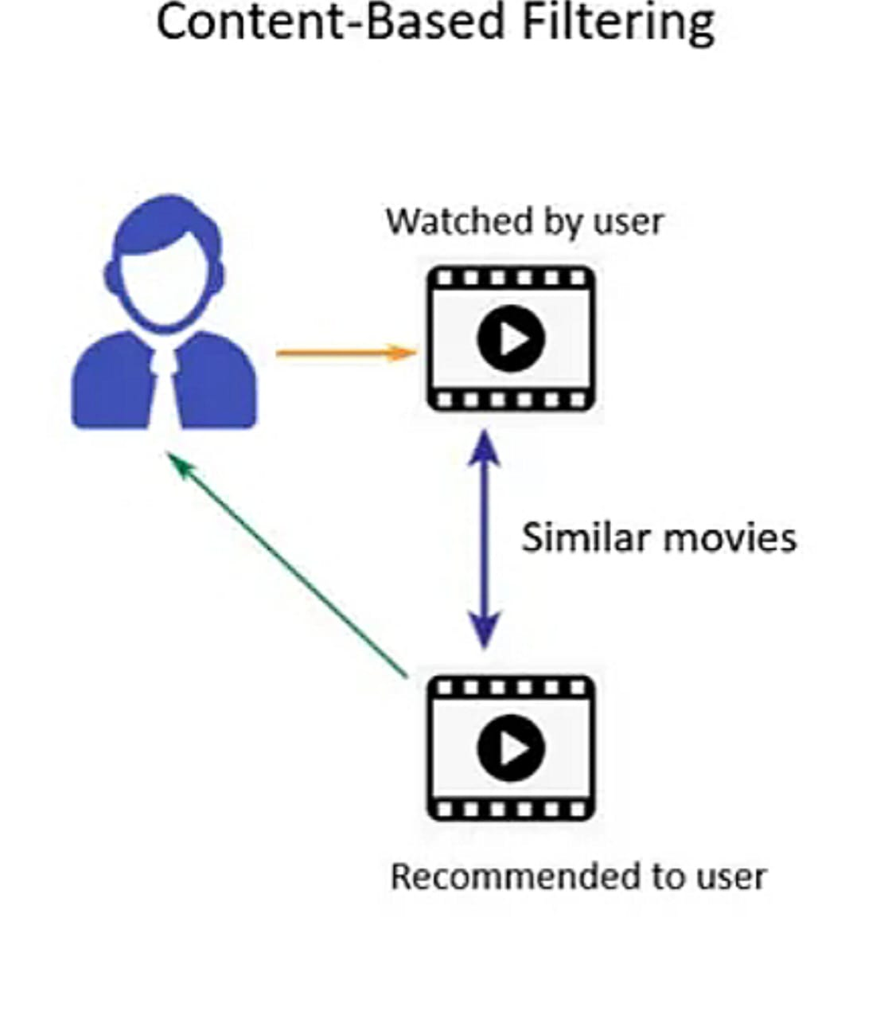
CONTENT-BASED FILTERING:
Recommends items based on user preferences.
Analyzes item features like genre, actors, etc
Builds a profile using past interactions.
Personalized Recommendations: Adapts based on changing user behavior.
Content Diversity: Introduces new items beyond frequently watched genres.
Example : Suggesting action movies if the user watches action films.

Slide 14



WHAT MAKES US UNIQUE?
Personalized Suggestions
Dual Filtering Techniques
Easy-to-Use Interface
Delivers movie recommendations tailored to each user’s viewing history and preferences.
Uses both Collaborative and Content-Based Filtering to enhance accuracy in movie recommendations.
User-friendly design makes discovering your next favorite movie simple and seamless.

Slide 15
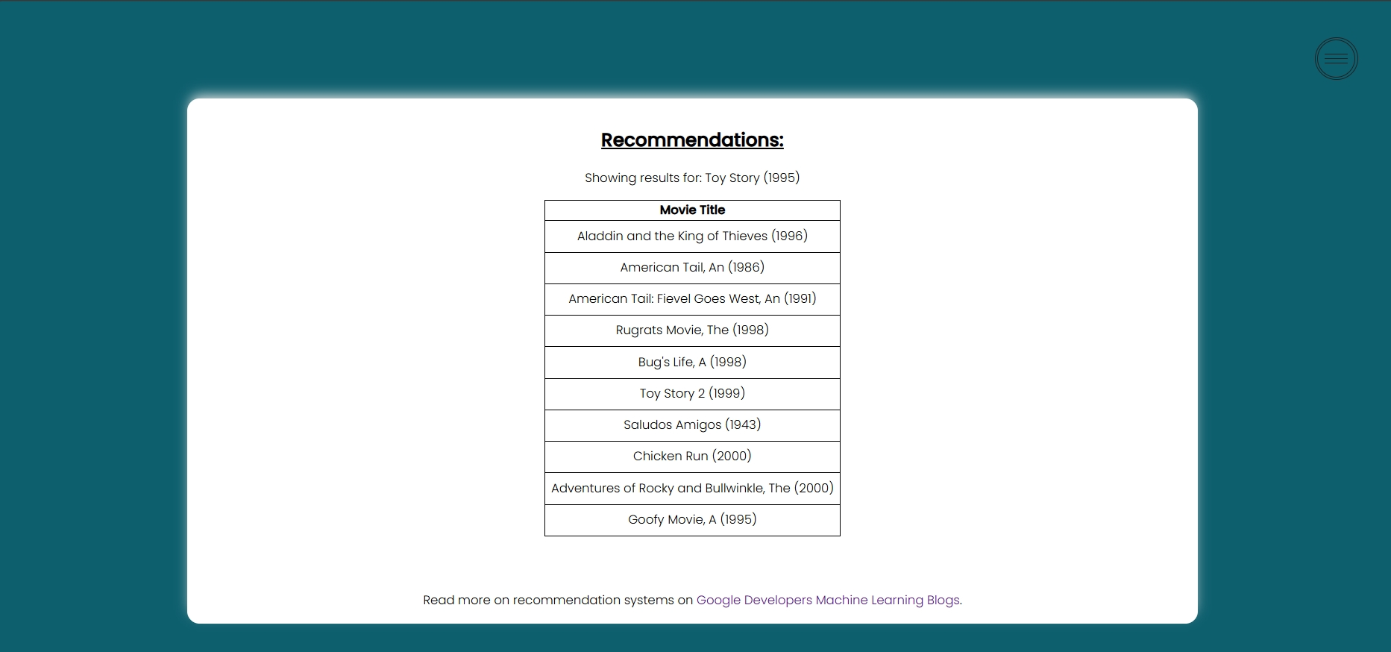
RESULT & ANALYSIS:
The system takes an input movie (e.g., Toy Story (1995)) and provides a list of recommended movies.
Recommendations are generated using Collaborative Filtering and content –based filtering analyzing user preferences and movie similarities.
The output showcases relevant movies with similar themes, genres, or audience preferences.
Example: The image shows recommendations for Toy Story (1995), including animated and adventure films like Toy Story 2, A Bug’s Life, and Chicken Run.

Slide 16





CONCLUSION:
The Movie Recommendation System successfully suggests movies to users based on Collaborative Filtering and content-based filtering techniques. The system enhances user experience by providing personalized recommendations.

Slide 17
ANY QUERIES:
🏁 Closing With Gratitude
🙏 Thank you for your time and kind attention. We sincerely welcome your questions or suggestions to help us grow and improve.

Slide 18

Thank You!

